Slide 1
Sexual Orientation
A Biological and Genetic Factor

Slide 2
What is sexual orientation?
“Sexual orientation refers to an enduring pattern of emotional, romantic, and/or sexual attractions to men, women, or both sexes.”
Human sexuality is highly varied and contains many grey areas.
  Heterosexuality
  Homosexuality
  Bisexuality
  Asexuality
  Pansexuality
  Demisexuality

Slide 3
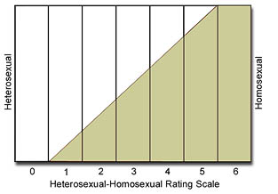
History
Human sexuality is a topic not often discussed openly. It wasn’t until the late 1940s, when Alfred Kinsey revolutionized sexology, there was proper research on the matter.
Kinsey developed The Kinsey Scale in an attempt to describe a person’s sexual orientation.
0- Exclusively heterosexual with no homosexual
1- Predominantly heterosexual, only incidentally homosexual
2- Predominantly heterosexual, but more than incidentally homosexual
3- Equally heterosexual and homosexual
4- Predominantly homosexual, but more than incidentally heterosexual
5- Predominantly homosexual, only incidentally heterosexual
6- Exclusively homosexual
X- Asexual, nonsexual

Slide 4
Why is this an issue?
All around the world, people are failing to recognize that sexual orientation is something that cannot be chosen, as it’s genetic. Because of this thousands of people are victims of hate crimes and discrimination from society, legal rights are denied, and even medical concerns are raised.
Eliminating the ignorance that surrounds the issue can lead to eliminating many of the societal issues.
A sample viewpoint
The more people who ignore the genetic predispositions, the bigger the issues become.

Slide 5
Rights denied
Hate crimes, discrimination, and legal rights are some issues lack of understanding brings in regards to sexual orientation.

Slide 6
The science (and technology) behind sexual orientation
Prenatal hormones, Brain structure and physiology, and Genes vs. environment

Slide 7
Prenatal Hormones
Sex differences begin to appear in fetuses beginning at about seven weeks. Testosterone differences between males and females influencing sexual behavior begin.
Studies on individuals born with hormonal differences such as CAH (congenital adrenal hyperplasia).
“Masculine” hormones, “feminine” hormones may influence sexual orientation.
Fraternal Birth Order Effect: the more older brothers an individual has, the more likely a homosexual sexual orientation (28-48%). Due to high production of testosterone antibodies mother produces; each male fetus makes her more “immune” to testosterone production.

Slide 8
Brain structure and physiology
LeVay (1991) first studied differences in the brains of heterosexual and homosexual men and women. LeVay found the Third Interstitial Nucleus of Anterior Hypothalamus (INAH-3) to be smaller in homosexual men which is a trait matching heterosexual women.
“[the finding] indicates that INAH is dimorphic with sexual orientation, at least in men, and suggests that sexual orientation has a biological substrate.“
Corpus Callosum also differ in size between heterosexual and homosexual men in general.
More recent studies using MRI technology show an “anatomical mark” on the brains.

Slide 9
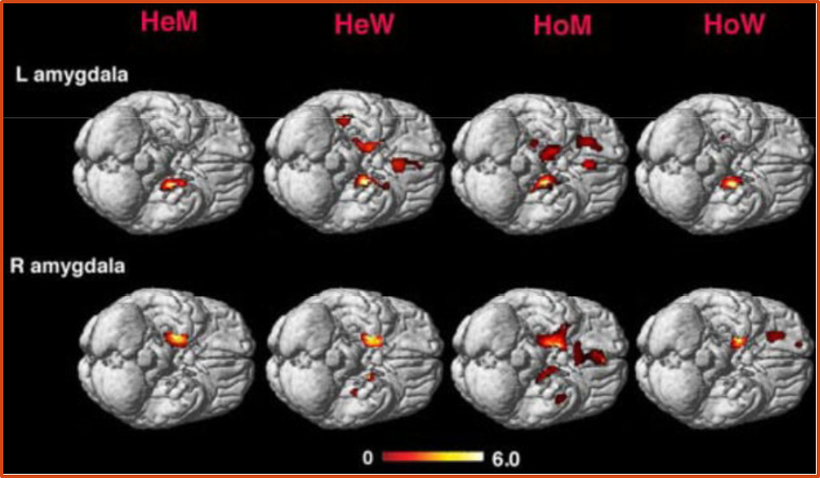
MRI scans indicate people attracted to women (HeM and HoW) had larger right brain hemispheres, and those attracted to men (HoM and HeW) had more symmetrical brains. Activity patterns in the amygdala (fight or flight response center) are also shown.

Slide 10
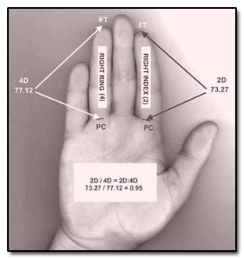
Digit ratio theory and handedness
2D:4D can indicate testosterone and estrogen levels.
Longer ring fingers indicate more testosterone, longer index fingers indicate more estrogen. Ring and index fingers of the same lengths have a high correlation with homosexual orientations (for both men and women).
Men and women who are left handed are also 50% more likely to have a homosexual orientation.

Slide 11
Genes vs. environment
Genetic marker Xq28 linked to homosexuality: similar traits present on this marker in homosexual men tested against heterosexual men.
Twin studies: twins raised apart are just as likely to share a sexual orientation as those raised together
Biological and adoptive studies show biological links to sexual orientation
Catch-22 of “nurture” debate: the more accepting a society is, the more likely someone will be open about sexuality, however society needs more exposure to become more accepting.

Slide 12
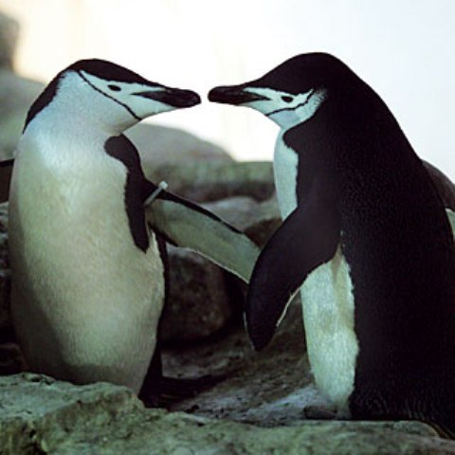
Sexual orientation in animals: homosexual and bisexual behavior is present in many animal species suggesting a biological force applicable to humans (particularly in non human apes)
Nematode worms and mice with manipulated brain chemistry have shown changes in sexual orientation.

Slide 13
What’s in store?
The future of the issue and conclusions

Slide 14
some good news!
The past few decades have made an enormous impact on genetic research. Genetic mapping that used to cost millions of dollars now costs several thousands.
The accessibility of such genetic research can lead to further knowledge of how sexual orientation is developed and as the information becomes more widespread, hopefully the ignorance that causes the bulk of the issue will be resolved.

Slide 15
Understanding human sexuality has come a long way, but there are still limitations and issues in the matter.
Fortunately, we have the scientific and technological support for this issue in general which can hopefully lead to wider acceptance, until then however, it’s up to society to help resolve these issues.

Slide 16
Courtney bechtel
November 1, 2011.

